Slide 1

STACK
MK Algoritma dan Struktur Data
INFORMATIKA INSTITUT TEKNOLOGI TELKOM SURABAYA

Slide 2
STACK
A stack is a linear data structure that follows the principle of Last In First Out (LIFO).
This means the last element inserted inside the stack is removed first.

Slide 3
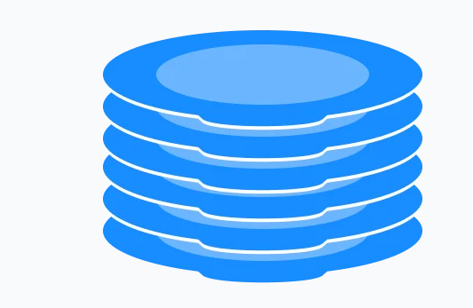

Slide 4
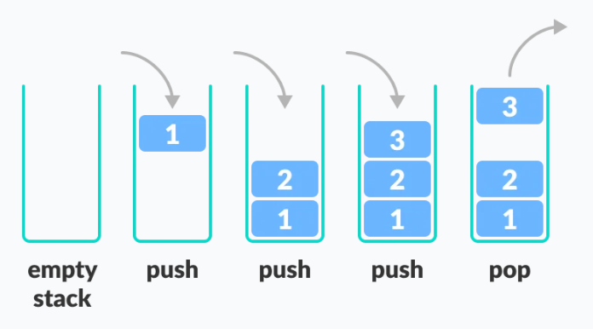
LIFO
In programming terms, putting an item on top of the stack is called push and removing an item is called pop.
In the above image, although item 3 was kept last, it was removed first. This is exactly how the LIFO (Last In First Out) Principle works.

Slide 5
OPERATION
There are some basic operations that allow us to perform different actions on a stack.
Push: Add an element to the top of a stack
Pop: Remove an element from the top of a stack
IsEmpty: Check if the stack is empty
IsFull: Check if the stack is full
Peek: Get the value of the top element without removing it

Slide 6

INISIALISASI

Slide 7
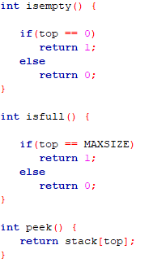
isEmpty, isFUll, peek

Slide 8
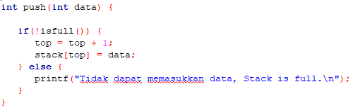
push

Slide 9
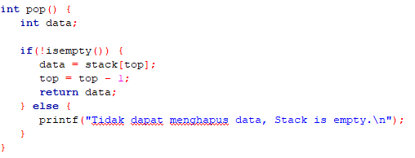
pop

Slide 10
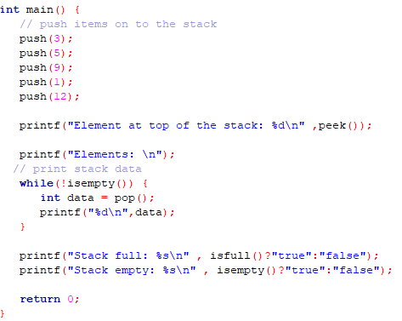
main

